Slide 1



Market Analysis in Chennai for Hotel Business
By S. Saravanan
For Coursera Data Science Capstone Project

Slide 2
Introduction
To Do a Market Analysis in Chennai for Recommeding a Good place to start Hotel Business

Slide 3
Data Scrapping
Data are majorly obtained from 2 different sources
Wikipedia [ For Areas in Chennai]
FourSquare API [ For location coordinates, Venue details in the location, etc.]

Slide 4
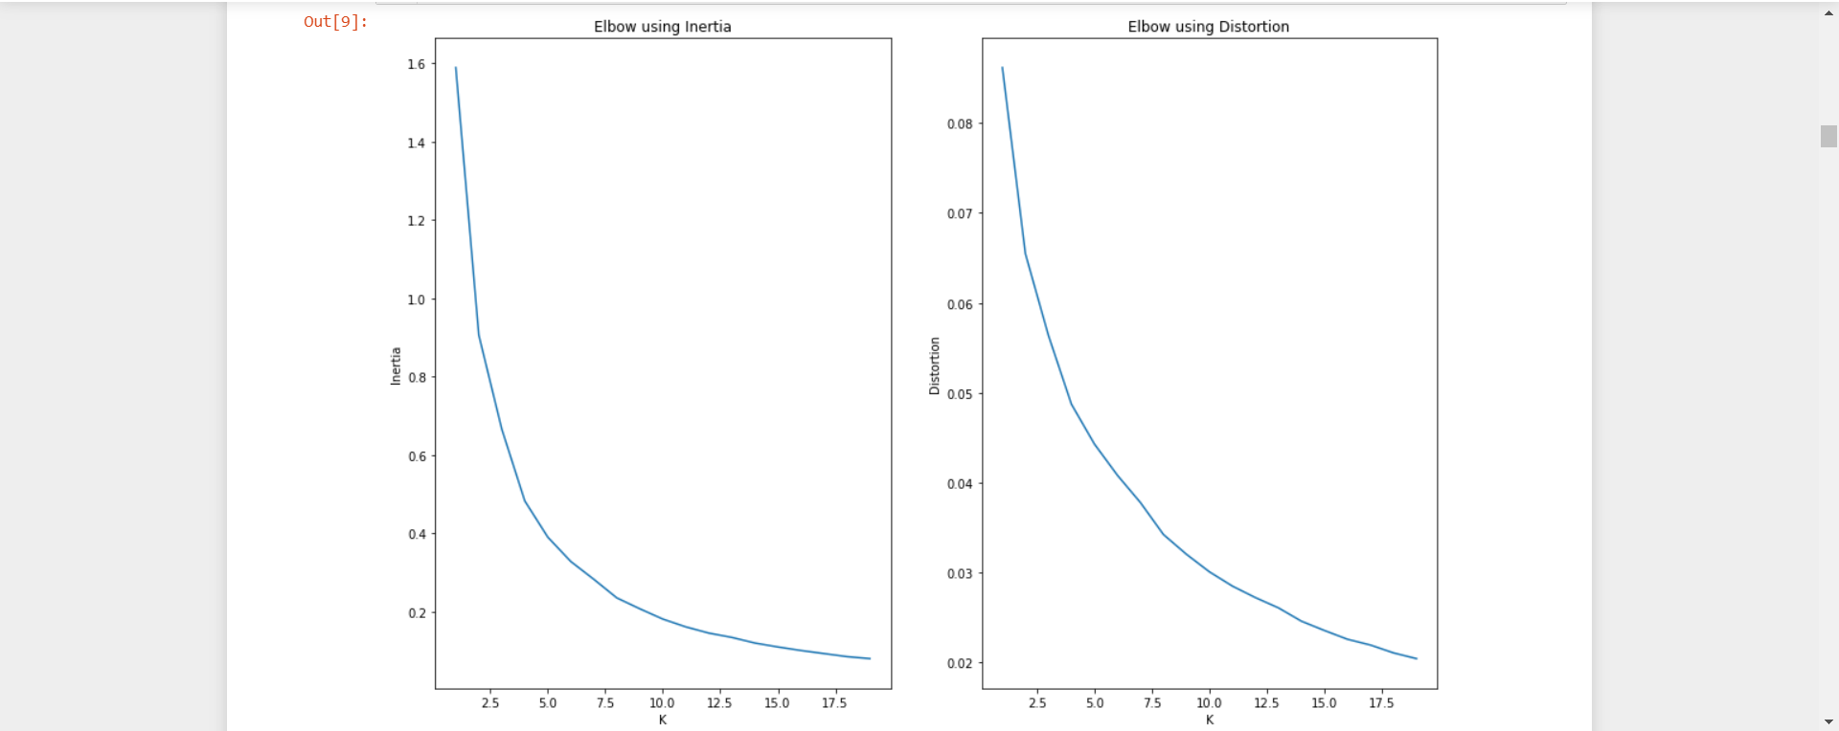
Methodology
Kmeans Clustering algorithm to cluster the areas based on geographical Coordinates
Elbow method to find out the ‘K’

Slide 5
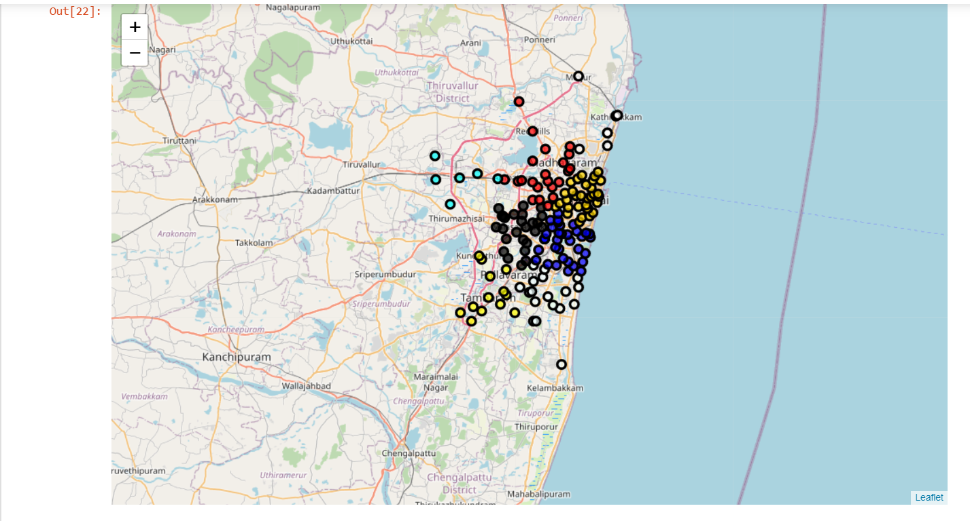
Clustering of Areas into 8 Segments

Slide 6
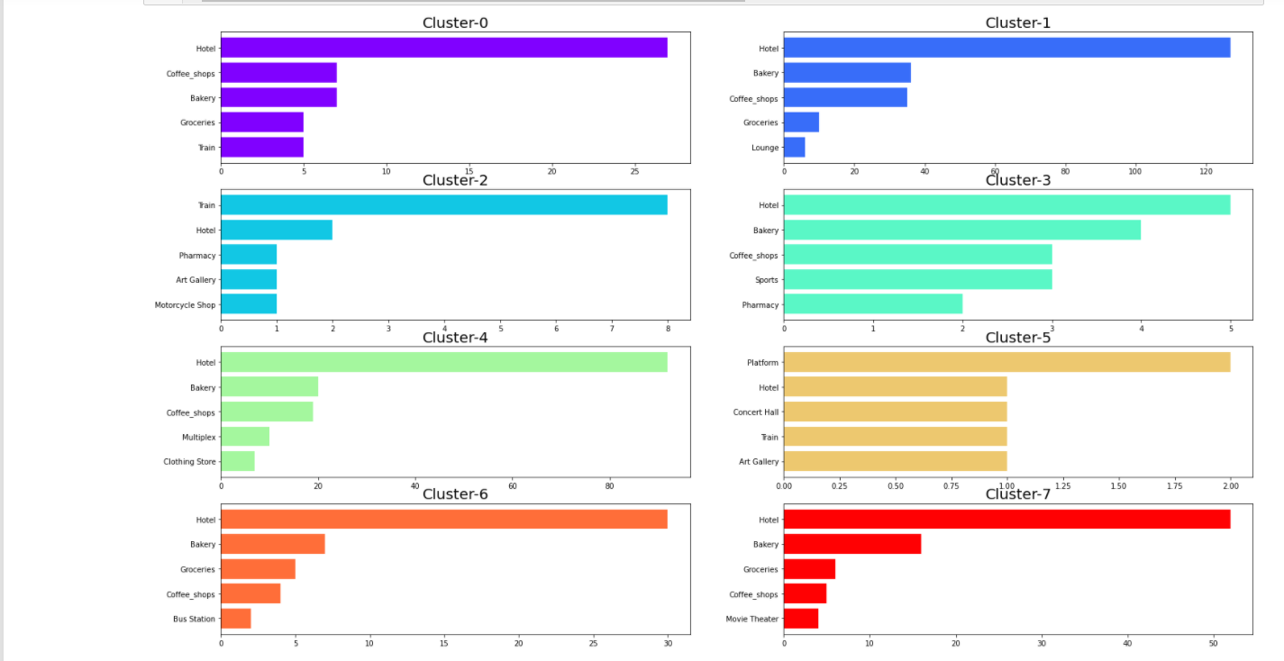
Discussion

Slide 7
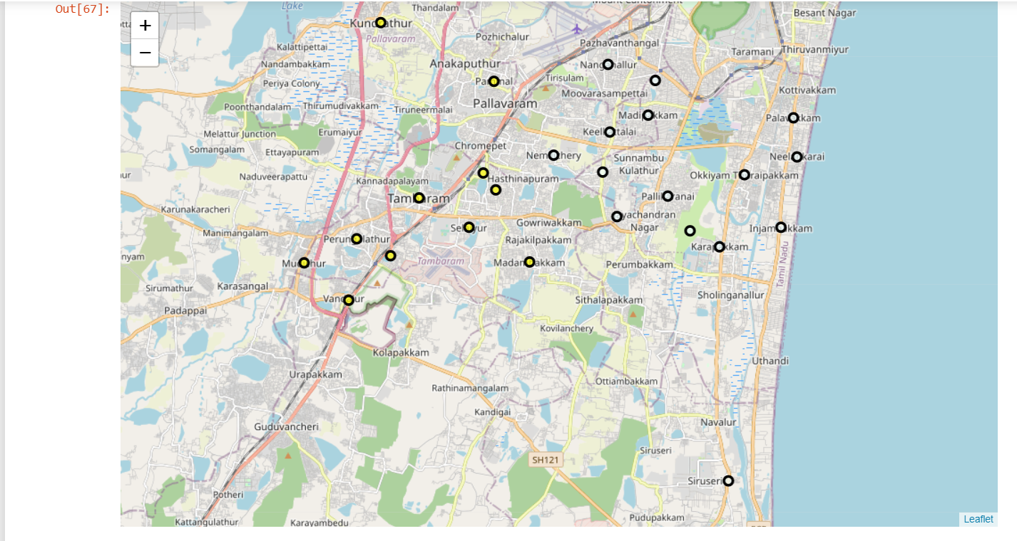
Results
Cluster 3 and Cluster 6 are the best locations to setup Hotel

Slide 8
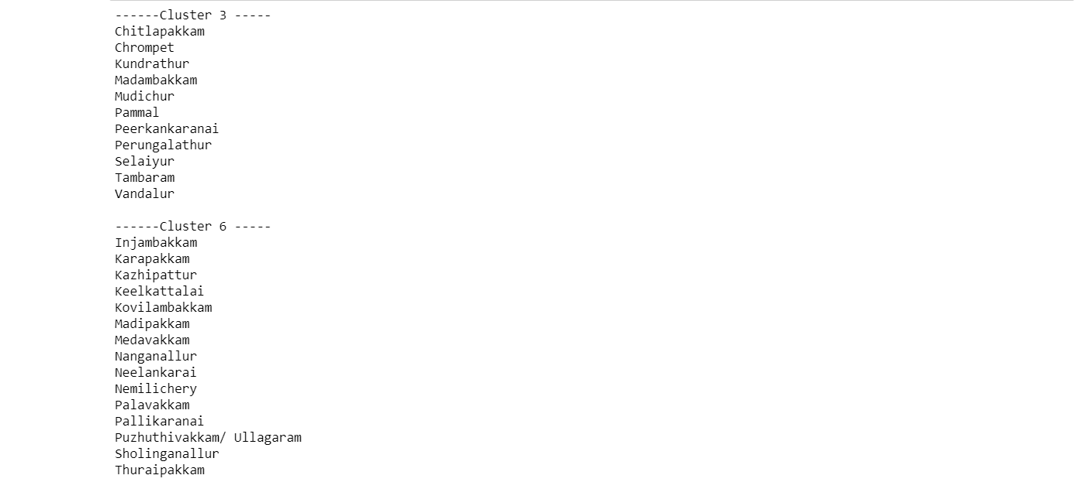
Conclusion
The following areas are best to setup Hotel in Chennai

